Slide 1

Natural Language Processing using Machine Learning on
Amazon Products reviews
Elad Eliav and Elad Sela
Final Project
NAYA college
Practical Data Science
October 2021

Slide 2
Our Goals
85% accuracy for classification reviews
Using BERT
Learning

Slide 3
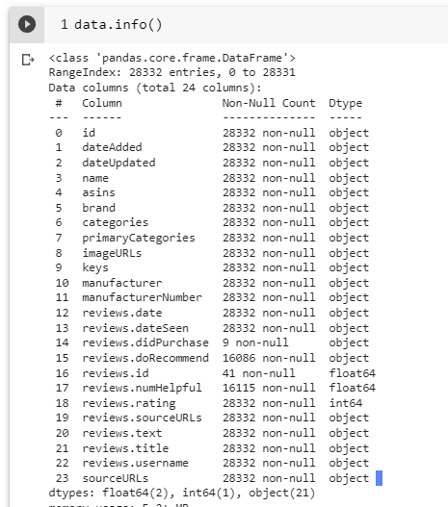
The DATA
Retrieved from Kaggle
28K records dataset of amazon products reviews and rating
Our main objectives
Find a sentiment in free text reviews that can predicts the rating score of the product
Create ML algorithm that weight reviews by scoring their authenticity

Slide 4
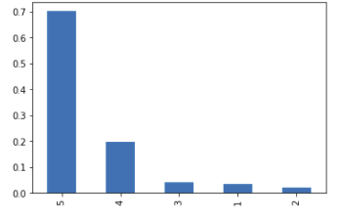
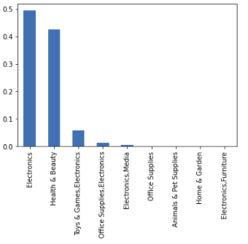
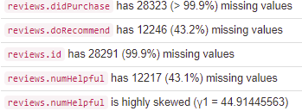
EDA
Imbalanced data – 70% of data got 5 stars rating
High percentage of missing values in few columns
Numbers of product categories is very limited

Slide 5
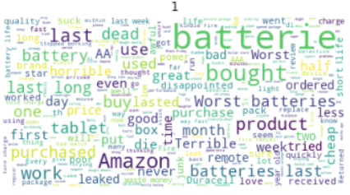
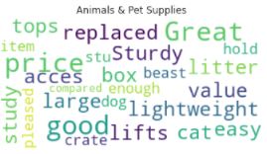
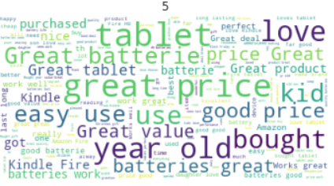

Word Clouds
Representation of Word Clouds by primary category and by rating review score

Slide 6
Data Pre-Processing
Remove columns with high missing values percentage
reviews.didPurchase
reviews.id
reviews.numHelpful
Fixing reviews free text before using NLP ML models
Replace all words to lower case
Remove non alphabetic chars
Remove double spaces

Slide 7
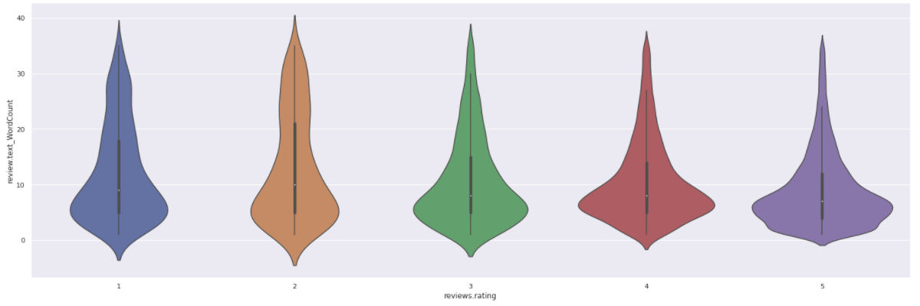
Future Engineering
Add column of word count for each review
Found out:
Median number of words in review is 10
As rating of product is higher the less words used in review in average

Slide 8
Data Cleaning
Remove rows with review word count is 0 or gather then 35 words – 4% of total rows
Remove rows with nulls in important columns:
Username
Title
Text
Rating
- 0% of total rows

Slide 9
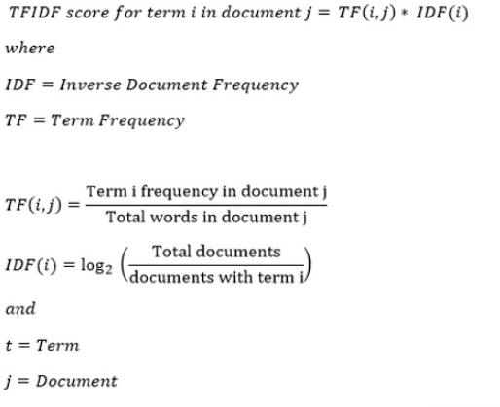
Machine learning - Three Classifiers using TF-IDF vectorizer
TF-IDF is a statistical tool that aims to reflect the importance of words in the giving document collection – Amazon products reviews in out case
We choose three classifiers to use on top of TF-IDF vectorizer in a pipeline, to predict rating score of amazon reviews
After that using three classifiers we enabled voting (hard and soft) to choose a predicted rating score

Slide 10
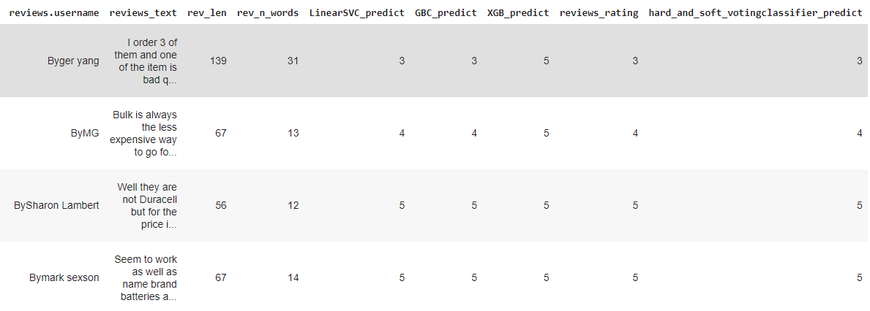

Slide 11
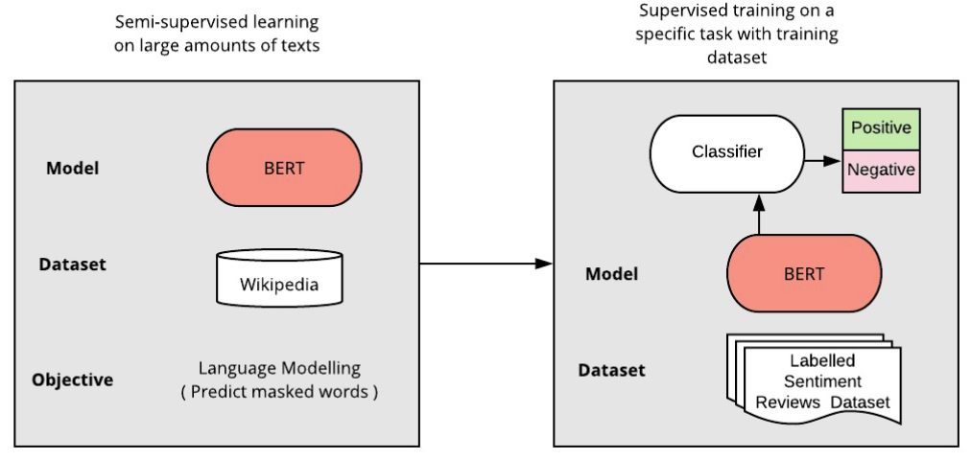

Deep Learning – BERT
BERT (Bidirectional Encoder Representations from Transformers) was invented by researchers at Google. the model looking at a text sequence by jointly conditioning on both left and right context.
An attention mechanism that learns contextual relations between words (or sub-words) in a text.

Slide 12
Accuracy Scores
Model | Linear SVC | Gradient Boosting Classifier | XGBoost | BERT
Accuracy Score | 0.84 | 0.81 | 0.72 | 0.83

Slide 13
Our Challenges
Time management
Using BERT on Google Colab
Fine tuning of the models

Slide 14


